Slide 1






CAPESTONE PROJECT ON FITNESS

Slide 2
CONTENTS
Introduction of the project
Database design
ER Diagram With Relationships
SQL Queries
Insights and Analysis
Challenges faced and conclusion

Slide 3
Introduction to the Project and Its Real-World Relevance
Project Overview:
Designed to manage members, trainers, classes, and attendance.
Streamlines operations and enhances customer experience.
Analyzes member behavior, trainer performance, and class popularity.
Real-World Relevance:
Helps fitness clubs optimize schedules and track engagement.
Provides structured data for insights into business operations.

Slide 4

Database Design
Key Entities :
Members: Name, membership type, fees.
Trainers: Specialty, hire date.
Classes: Class details, trainer assignment.
Attendance: Member participation, class date.
Relationships :
Members → Classes (via Attendance).
Trainers → Classes.
Normalization :
Efficient storage, reduced redundancy, optimized queries.

Slide 5
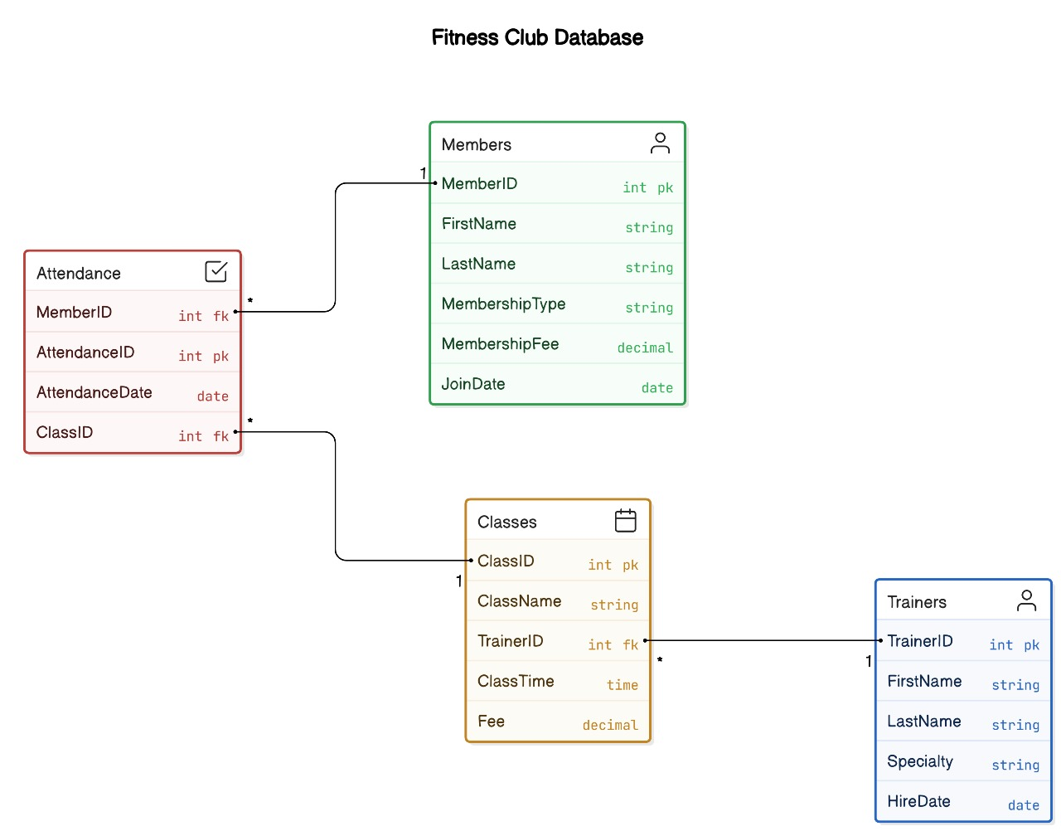
ER Diagram With Relationships

Slide 6
Sample SQL Queries
Query: Retrieve Member and Trainer Information
SELECT
Members.FirstName AS MemberFirstName,
Trainers.FirstName AS TrainerFirstName,
Classes.ClassName,
Attendance.AttendanceDate
FROM Attendance
JOIN Members ON Attendance.MemberID = Members.MemberID
JOIN Classes ON Attendance.ClassID = Classes.ClassID
JOIN Trainers ON Classes.TrainerID = Trainers.TrainerID;
Purpose: List members, trainers, and attended classes.

Slide 7
7
Query: Average Attendance Per Class
SELECT
Classes.ClassName,
COUNT(Attendance.AttendanceID) AS AttendanceCount
FROM Attendance
JOIN Classes ON Attendance.ClassID = Classes.ClassID
GROUP BY Classes.ClassName;
Purpose: Identify class popularity.

Slide 8
Insights Gained
8
Popular Classes:
Attendance data highlights member preferences.
Optimize schedules and allocate resources effectively.
Trainer Performance:
Track trainer popularity through attendance trends.
Adjust class offerings or trainer schedules as needed.
Revenue Analysis:
Evaluate membership fee payments.
Analyze revenue from membership types and class participation.

Slide 9

Challenges and Solutions
Data Integrity:
Challenge: Maintaining consistent data across tables.
Solution: Foreign keys and referential integrity.
Complex Queries:
Challenge: Handling multi-table joins and aggregates.
Solution: Step-by-step query building and testing.
Scalability:
Challenge: Managing increasing data volume.
Solution: Indexing frequently queried columns.

Slide 10
Thank You
10
SUPARNA-24WU0202345
SRIPRIYA-24WU0202378
NIKHIL-24WU0202330
AKHIL-24WU0202343
SHREYA-24WU0202347
POOJA JAJU-24WU0202353

